Slide 1
Software Development with UML and Java 2
Sockets intro

Slide 2
Agenda
Sockets
Communication between two programs

Slide 3
Client-server communication
We want to have a program running on one computer talk to a program running on another computer.
The client requests something from the server
The server serves the client

Slide 4



Slide 6






Bank dude
Receptionist

Slide 13

Socket concepts
Socket class
ServerSocket class
These are used as communication-devices
Socket communication uses TCP, in a way to ensure no data is lost. And that everything sent, arrives in the same order.

Slide 14
Socket concepts
Client
Server

Slide 15
Example, Server side
Echo server, to upper case.
Client
Server

Slide 16
Example, Server side
Echo server, to upper case.
hello
SEND
Client
Server

Slide 17
Example, Server side
Echo server, to upper case.
hello
Client
Server

Slide 18
Example, Server side
Echo server, to upper case.
HELLO
SEND
Client
Server

Slide 19
Example, Server side
Echo server, to upper case.
HELLO
Client
Server

Slide 20


Slide 21
The code

Slide 22
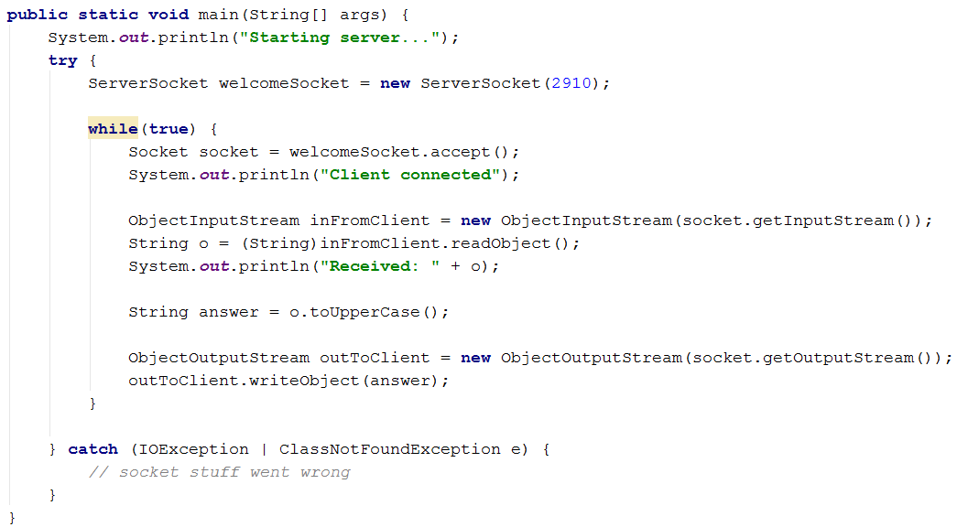

Slide 23
Creating a server socket. This receives incoming connections requests.

Slide 24
Server socket accepts a connection.
This is our front desk manager in the bank

Slide 25
A new socket is created to handle the client. This was the manager in the back of the bank.

Slide 26
Create ObjectInputStream to receive objects sent from the client.

Slide 27
Receive object from client. I know I send Strings, so I cast it.

Slide 28
Create server response.

Slide 29
Create ObjectOutputStream, used to send objects to the client.

Slide 30
Send response object to client.

Slide 31
While(true), so we go back to waiting for a new client connection request with the welcomeSocket.accept();

Slide 32
The program is waiting here. I.e. only one client can be served at a time.

Slide 34


Slide 35
The client side

Slide 36
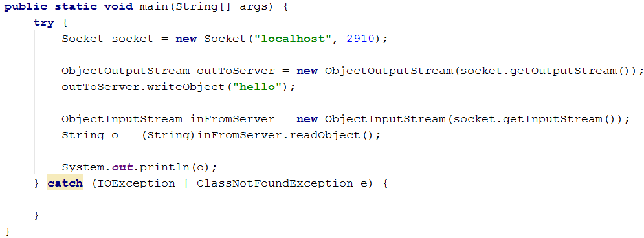

Slide 37
Create a socket, which tries to connect to a server at the given IP and on the given port.
My server is running locally, so I use “localhost”. Could have been e.g. “192.168.1.38”

Slide 38
Used to send objects to the server.

Slide 39
Send object String(“hello”)

Slide 40
Used to read objects from server

Slide 41
Receive response from server

Slide 43
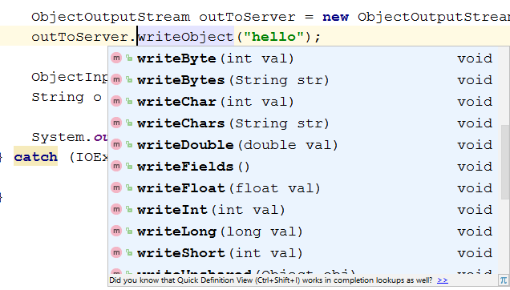
The ObjectInputStream and ObjectOutputStream can send other things than objects

Slide 44
Demo

Slide 45
Usual we want to send something more complex than just a number or a String.
Any object, which implements Serializable can be sent, assuming all field variables are also Serializable.
In SEP2 you’ll be sending Objects instead of Strings:
Message msg = (Message) inFromClient.readObject();

Slide 46


Slide 47
Currently there were places in the code, which was waiting for something to happen:
A client connects
An object is sent from the client
This blocks other clients, see exercises.
Next time we’ll solve this using threads.

Slide 48
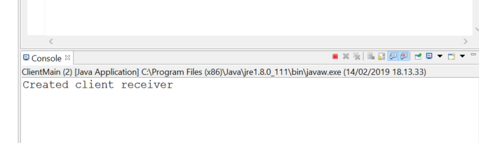
Final note
Eclipse will show the console for one program at a time. If you’re running both a server, and a client, you will only see one of them.
You can create two consoles, I don’t know how.
Click red square to close program, click cross to close console. Another program will be shown in console then.
Name of program shown in console
Click here to switch console, or see drop down.

Slide 49


Slide 50
Exercises

